Slide 1
Camera Boom Project
By
Jonathan Greenberg and David Furfaro

Slide 2
Project Goals
•Develop a mechanism that can take still photos
•Allow the mechanism to be controlled by a web interface
•Enable the interface to move the camera in any direction
•Any picture taken must be sent back to a saved location

Slide 3
Hardware
Raspberry Pi 2
Camera Module
Servo Controller Board
2 Micro Servos
Screws, Plastic Mounts

Slide 4
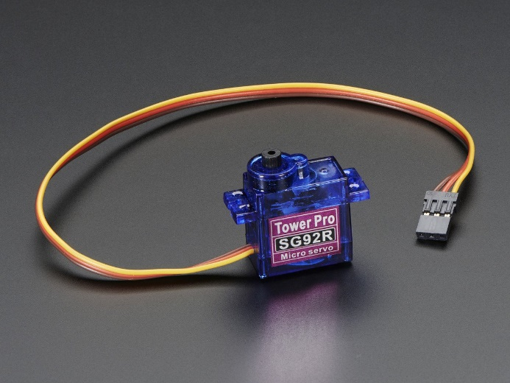
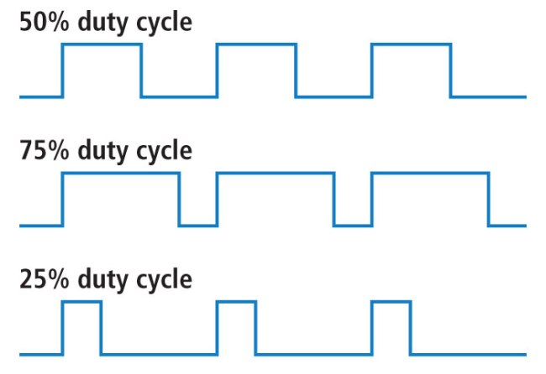
How Servos Work
A servo is controlled by a PWM (Pulse Width Modulation) signal.
A PWM is a series of repeating electrical pulses that vary in width/duration.
A servo has three wires, two for power, one for control, which sends the pulses to the servo.
Rotation of the servo is based on the duration of the pulses.
The longer the pulse, the more the servo rotates.
Different servos have different rotations limits and therefore, have different pulse duration ranges.

Slide 5
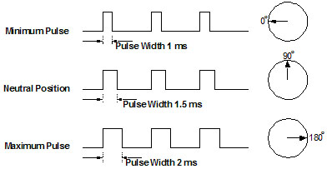
How Servos Work cont.
Each servo has a neutral position, which is where the servo can rotate the same amount to left as it can to the right.
Pulses usually have three parameters, a minimum pulse width, a maximum width, and a repetition rate.
On average, the minimum width is usually 1 ms (milliseconds), the maximum width is 2 ms, and the repetition rate is 20 ms.

Slide 6
ServoBlaster
A driver created by Richard Hirst (richardghirst)
Allows user to produce PWM signals from any GPIO pin on the Pi.
Servos rotate based on commands sent to the driver. The command designates a pulse width that is sent to the servo.
The servo stays at the specified position until another command with another width is inputted.

Slide 7
Camera Module - Mjpg Streamer
Mjpg-Streamer is a command line application created by Tom Stoveken
Liam Jackson forked the application and made it applicable to the Raspberry Pi

Slide 8
Implementation of Hardware
The micro servers were connected with plastic mounts in order to create a Pan/Tilt bracket
The camera module was screwed into the pan micro server
The wires coming from the micro servers were connected to the servo controller board
The servo controller board was connect to the Pi via GPIO
The camera module was connected to the Pi via a slot in between the HDMI slot and Headphone Jack

Slide 10
Software and Languages
Flask
Python
HTML

Slide 11
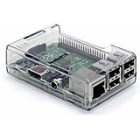

Implementation of Software
Flask
Browser
Python Functions
HTML
(Server)
(Client)

